Slide 1
NYMBUS Case Study
Jack giannini

Slide 2

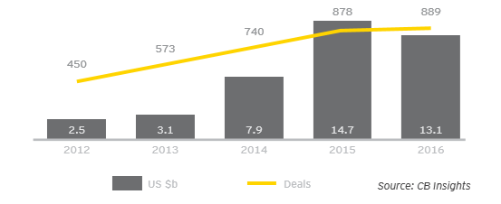
Digital Banks
Key trends
Investments
Digital Banking is the movement from the traditional banking methods to a web-based platform.
In 2012, roughly 3 billion was invested in Fintech Investments. That number rose to 13 billion by 2016 .
A major Financial Technology company that has allowed banks to seamlessly move to a digital platform is NYMBUS.
NYMBUS offers five products that allow banks to compete in the digital era but all of the products can be seen in the all-in-one Smart Launch product.

Slide 3




NYMBUS Smart Launch
The NYMBUS Smart Launch product is a full-scale digital bank in a box.
For a fixed monthly cost of $40,000 and $3 per user Smart Launch is a full-scale, online only, digital bank.
It offers all the aspects of a traditional bank from, marketing, operations, card management, accounting, information technology, and customer support.
Smart-Launch integrates directly into the Financial Institutions core system and under their current charter.
90 Days until launch
https://vimeo.com/363165719

Slide 4
Current Banks Using NYMBUS
Technology
Centier Bank
Bank MD
Pacific National Bank
bullhttps://vimeo.com/368861231et point here
The main technology used by NYMBUS is an open architecture API. By using this technology it allows for constant innovation by seamlessly integrating new and emerging products and third parties without the outdated middleware costs and time.

Slide 5

Summary
Financial services market across the globe are undergoing revolutionary changes in technology. The roles of today’s banks are becoming diminished because individuals and institutions have an opportunity to create better, faster, and cheaper services. Through collaboration and innovation traditional banking institutions will have the opportunities to partake in the digital transformation. Banks will need to challenge the current technology in place and be willing to adjust strategies to

